Slide 1
1. Software Design
SWE 2410 Software Design
© 2026 Dr. Rob Hasker
Notes:
Reading: Java Design Pattern Essentials, Chapter 1

Slide 2
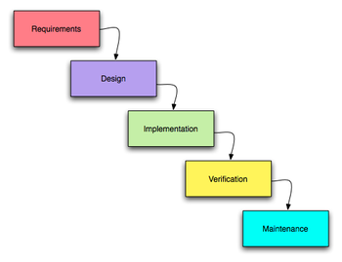
Software Design
Known as waterfall model
  Each element feeds into next
Once upon a time: key model for developing software systems
  Problem: didn’t allow for refinement
Relevance: requirements drive design, design drives implementation
What do you think design means?
How does design fit in the software development?
Basic elements of software development:
Requirements: what the client needs the system to do
Design: how system meets goals
Implementation: writing the code
Verification: checking it works
Maintenance: changes after initial completion
Key words!
Notes:
Each part feeds into the next

Slide 3
Understanding design
Start by understanding requirements
  What the system does
Types of requirements:
  Functional: given a particular input, what is the output or action?
  Non-functional: constraints on how it works
    Speed
    Security
    Robustness
    ... and many others!
Design: structure, algorithms, other elements
  Essentially: a plan for an implementation that meets all requirements

Slide 4
What do we need from a good design?
CSC 1120, data structure material
CSC 3310, algorithms
Little discussion here
Efficient - computations are useless if late
  Important for big O
  But don’t have to optimize everything!
Maintainable
  Requirements change!
  As system used, people find things to improve
Testable
  Code is useless if it results aren’t correct
  Testing as you go is important, but not sufficient
    Need systematic testing, covering all requirements
  Could be manual, but then it’s too expensive to be done multiple times
    When a bug is found and fixed, definitely don’t want it to be reintroduced during future maintenance
  Conclusion: need systematic, executable tests – must design to this goal
Primary issue in this course
Secondary issue, but important
There are many other qualities as well, but we will start with these.

Slide 5
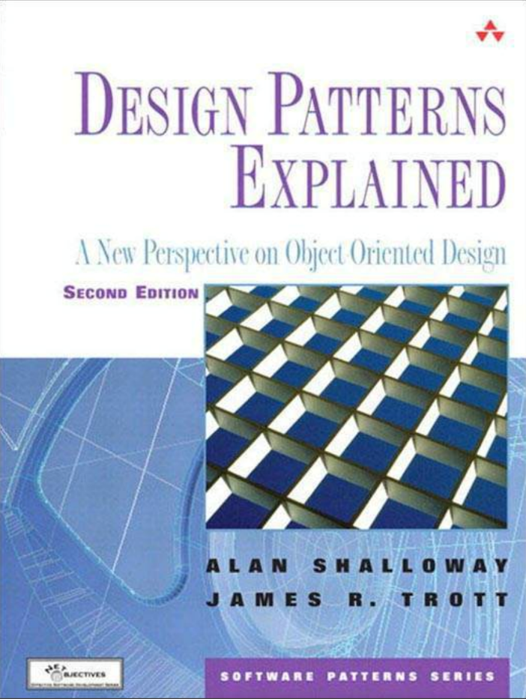
SWE 2410 Software Design
This course:
  Basic OO design: how to organize classes for understandability
  Design patterns: improving designs, making systems more maintainable
  Cloud patterns: designing for distributed computation
  UML: capture designs in simple diagrams
See syllabus link in Canvas
Required text:

Slide 6
Why OO?
What is the goal of object-oriented design/OO programming?
Why do we prefer OO designs?
What is the alternative?
Sample procedural design: suppose next classroom is DH 110
  Leave classroom, turn right
  Walk to stairway
  Take steps down one floor
  Go towards north entrance
  Look for first classroom door on your left
But not all students will go to the same room!
Notes:
Note: I don’t expect answers for the first two questions!
DH 240: the room next to Rosie; my assumption is that the current classroom is DH 210, so one might revise around that…

Slide 7
Why OO?
Extending to full class:
  Find schedules of all students
  For each,
    determine location of next room
    plan route to room
    give route to student
    review route with student to make sure no questions
Is this how you would solve the problem?
Better:
  List of rooms at back of class, directions for each
  Campus map, possibly highlighted with target locations
  Tell students to snap a picture of the map with their phones...
This makes the student responsible for finding the route!
Notes:
Note: I don’t expect answers for the first two questions!

Slide 8
A theme: remove if
Every object should be responsible for itself
  Operations which change the object should be part of the object
  Eg: a student object isn’t unregistered from a course by another object, it has an unregister method to do it for itself
If statements based on outside parameters release control
  X.f(int x): if x == 1 do a, x == 2 do b: callers of f dictate what to do
  Painful to test: have to confirm sequence right no matter how called
instanceof: yet another way to introduce outside control
  X.g(class x): if x instanceof Y do a else b: caller again dictates action
There are many other ways if statements make code complex
  Removing this complexity is hard, but critical to maintainable code

Slide 9
So OO it is, but how to start?
Could just sit down and dream up classes
Problem: random classes make maintenance hard
Observation: two distinct types of classes
  Classes specific to a particular implementation – containers, GUI elements, etc.
    These are known as solution classes – particular to one solution
  Classes that reflect objects in a problem: buildings, trees, people
    These are domain classes
    These relate to objects your clients know about
Domain classes localize requirements, make systems easier to modify
  Start designs by identifying domain classes!

Slide 10
Finding Domain Classes
A simple way to identify domain classes: nouns
  Objects are things, nouns name things, so nouns lead to domain classes
Example: application to find a place for lunch
  Don’t waste time on the question “where would you like to eat?”
  Have list of restaurants, spin a (virtual) wheel for a reasonably close location
Domain classes in this simple description:
  Meal (generalizing lunch), Restaurant, Location
  Problem descriptions typically name the obvious objects!
Basic principle: start with domain classes, add solution classes as needed

Slide 11
Review
How design fits into software process
  Requirements: what
  Design: how – plan for implementation
Core goals of design:
  understandability/maintainability
  efficiency
  testability
Identifying domain classes
  Domain/problem-space vs. solution-space classes
  Using nouns to identify classes
Next: how patterns fit into design

